Slide 1
Chapters 9, 10 & 15
Suffering apostles...

Slide 2
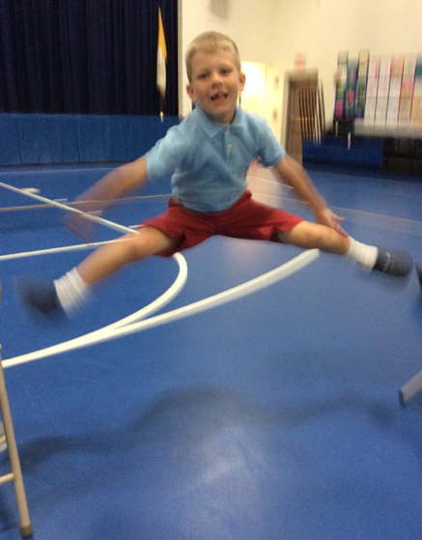
The meaning of suffering
How do we respond to suffering?
I am not saying we jump for joy over suffering...but it has its place.

Slide 3
The meaning of suffering
The modern response to suffering is nihilism (that nothing is of consequence) and atheism...all negative...all pointless

Slide 4
Suffering
What if you found answers to why suffering exists?
What if you recognized profound truths about yourself in suffering?
Having suffered...you can empathize with others.
Having suffered...you connect to God. He suffered.

Slide 5
Catholic guilt
What is conscience?
The Catechism stats that it is when man is alone with God whose voice echoes in its depths.
It's more than a feeling.
Peter weeps bitterly after denying Jesus the third time...WHY???

Slide 6
Catholic guilt
Have you ever gone against your conscience? It doesn't feel good...
Catholic guilt is a caricature.
The Catholic Church simply wants us to listen to what is written on our hearts.

Slide 7
The Apostles
BAPTISM
The Apostles are Flawed humans who are asked to follow a call...ummm...isn't that us?

