Slide 1
Chapter 3 The face of Christ

Slide 2
Chapter 3 The face of Christ
Jebel Musa- Mountain of Moses
Justinian, Byzantine emperor
St. Catherine’s, a monastery church dedicated to Mary and Christ’s transfiguration
Icon-a symbol that makes present what it conveys
Christos Pantokrator

Slide 3
Chapter 3 The face of Christ
Is an icon an idol?
God becomes man-God revealing Himself through the vessel of human flesh-which compels us to create, use our senses to understand the Incarnation. Christ Himself lived through human senses!
Icons are not idolatry-but an image of the Image

Slide 4
Chapter 3 The face of Christ
Idolatry is the attempt to control the divine
Through the Incarnation the gulf between human and divine were crossed!
We, as Christians can touch the truth of our salvation

Slide 5
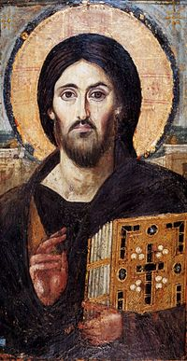
Chapter 3 The face of Christ
Christos Pantokrator
Left arm
Right hand
Index and middle fingers
Halo

Slide 6
Chapter 3 The face of Christ
God does not wait for us to realize our dependency, He comes to us through the Incarnation.
Jesus Christ reveals who we are, as well as who God is

Slide 7
Chapter 3 The face of Christ
Acta
Patrick J. O’Boyle
Karol Wojtyla “What happened?”
St. Augustine’s Confessions
Humanism vs. Humanism with God

Slide 8
Chapter 3 The face of Christ
The Church of the Holy Sepulcher
Omphalos-Navel-the center of the world, the center of history
St. Helena
Gnosticism
In His Holy Face, we meet the truth about ourselves, in the flesh

